Slide 1
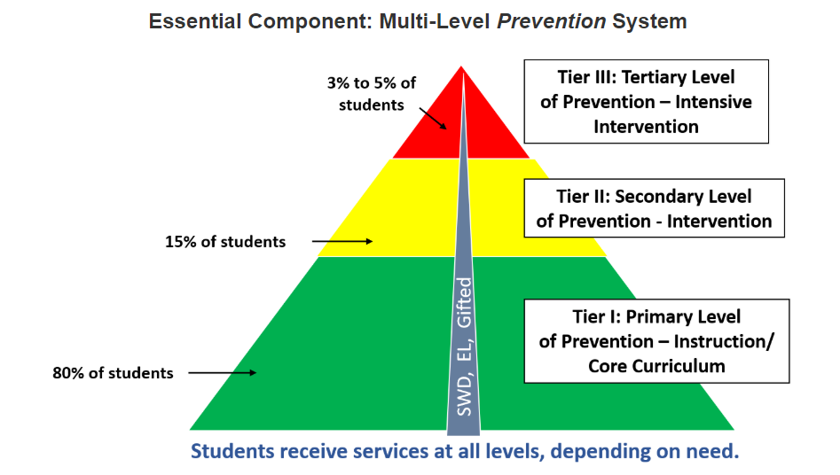
MTSS at Scott Elementary
MTSS stands for multi-tiered system of supports. It’s a framework many schools use to give targeted support to struggling students.
MTSS is designed to help schools identify struggling students early and intervene quickly. It focuses on the “whole child.” That means it supports academic growth, but many other areas, too. These include behavior, social and emotional needs, and absenteeism (not attending school).
The tiers of support are a huge part of MTSS. They get more intense from one level to the next. For example, a child getting small group interventions may need to “move up” to one-on-one help.
Contact Ms. K. McGowan at KMcGowan@apsk12.org
for additional information

